Slide 1



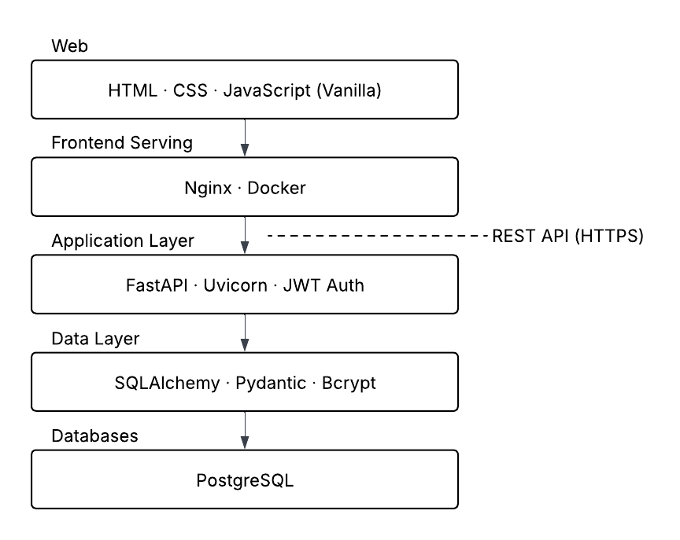
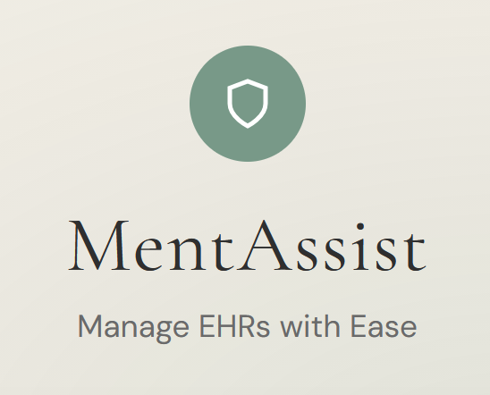
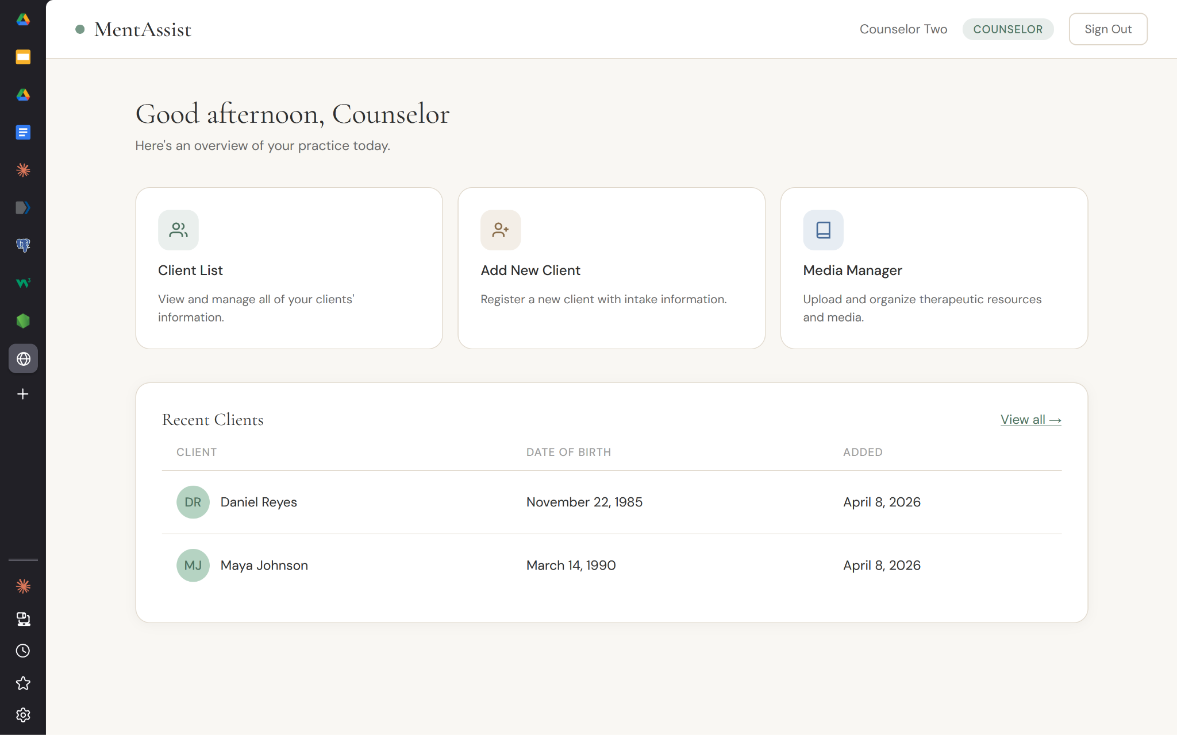
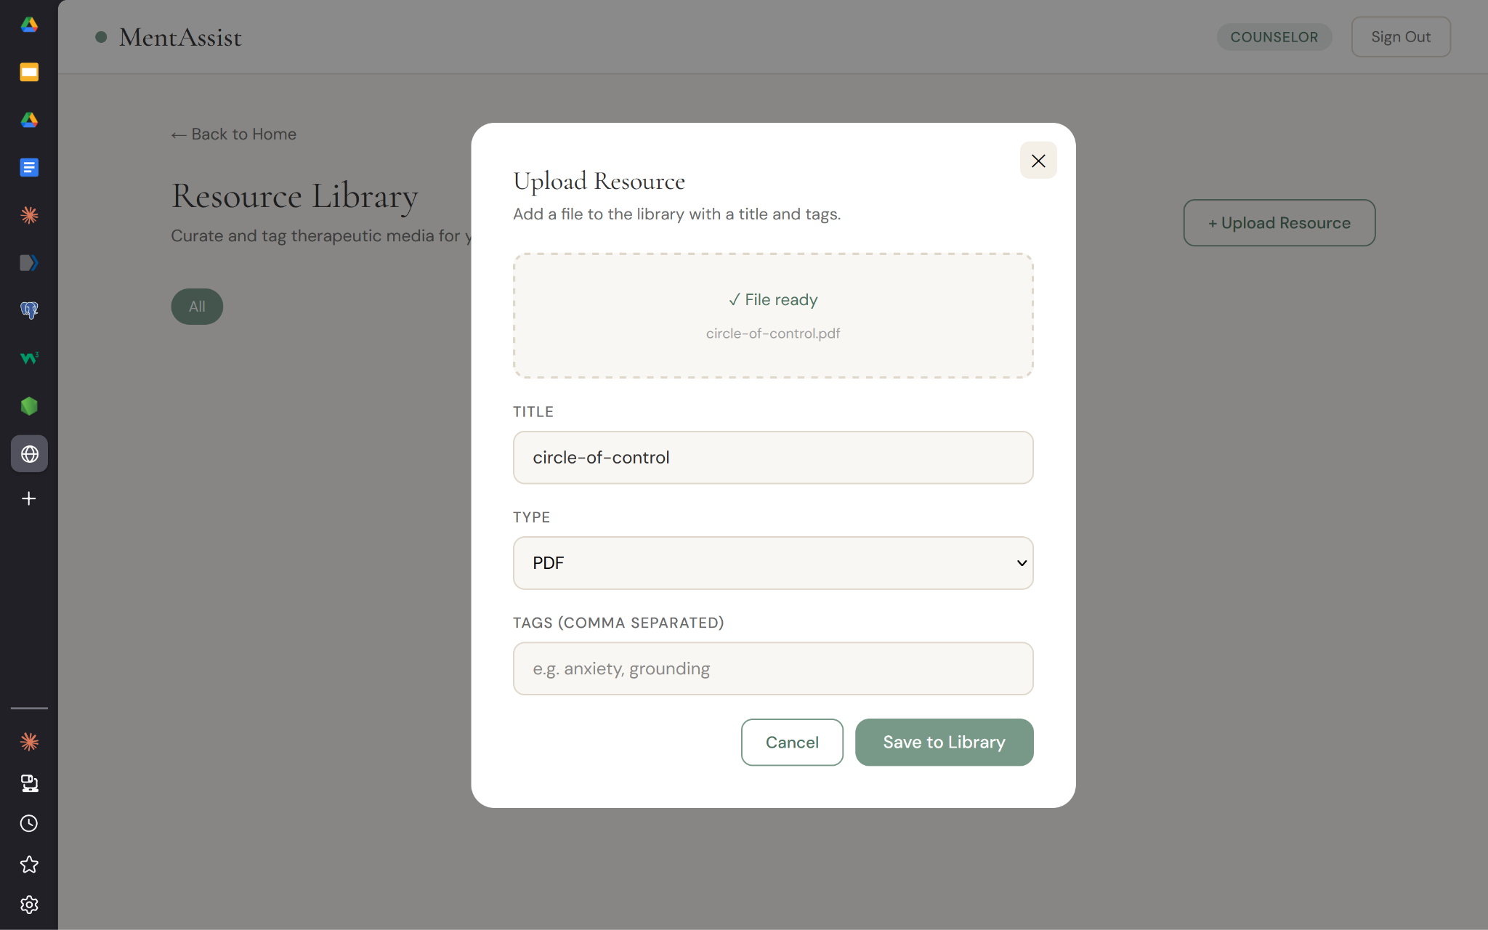
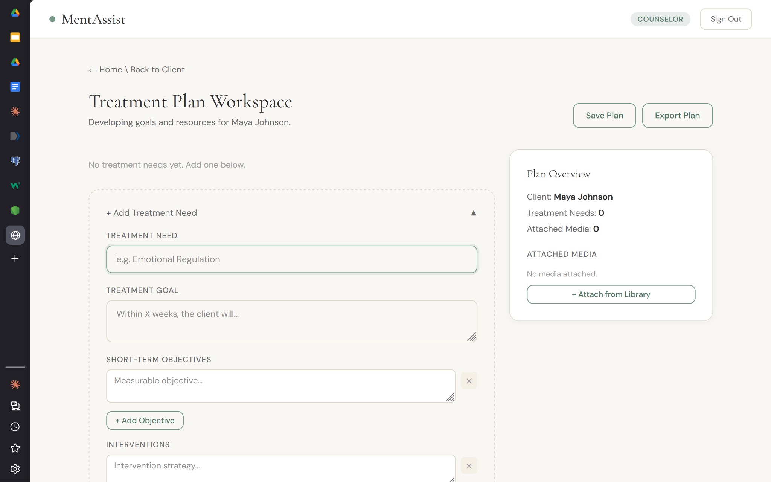
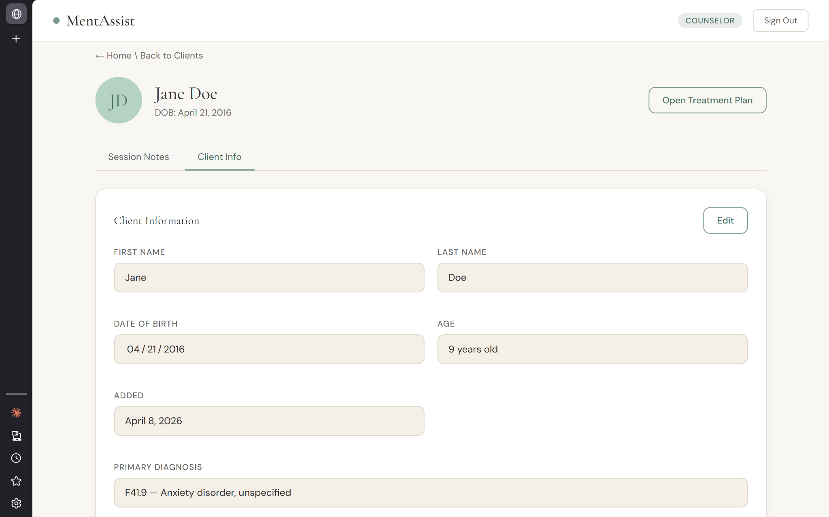
MentAssist – a Web-Based EHR Manager
C. Abdelhalim, B. Speed, E. Loft, B, Rader, R. Voiles, S. Whitlock
with Dr. Mengjun Xie, Department of Computer Science
Research Question
How can we build a modern, counselor-first platform that streamlines EHR management for mental health practitioners?
Introduction
Methods & Architecture
The healthcare industry is constantly searching for innovative ways to improve patient outcomes, including through streamlining administrative workflows by adopting electronic health record (EHR) systems.
MentAssist is a practitioner-focused online EHR system, designed specifically to enhance the experience of mental health workers in clinical environments. MentAssist stands out against competitors by prioritizing the practitioner. In addition to easily customizable treatment plans and client detail management, MentAssist also allows clinicians to create a library of resources for their clients.
To create a modern, user-friendly experience, MentAssist’s online frontend is built using HTML and CSS, with dynamic user interfaces supported by JavaScript. Frontend is served through a nginx server hosted on a Docker container, which in turn is supported by the backend technologies. Integration with the backend is enabled by FastAPI and Python, and databases are managed with PostgreSQL. Because of the sensitive nature of the information stored and served, JWT and Bcrypt were incorporated to ensure authentication and confidentiality with seamless integration.
MentAssist Logo
Architectural Diagram
Features
Conclusions
Resources
MentAssist’s key features include:
Centralized dashboard
Client list with actions
Client detail view and edit
Session notes
Treatment plan creator
Resource library
These features work to create a seamless workflow for practitioners, allowing them to manage client profiles, upload resources, and curate treatment plans on one connected platform.
MentAssist successfully demonstrates a practitioner-focused EHR platform that consolidates client management, structured treatment planning, and therapeutic resource organization into a single connected workflow. The system prioritizes the counselor experience while maintaining patient information confidentiality and a robust and extensible backend architecture. Data persistence across sessions ensures continuity of care documentation even when backend services are temporarily unavailable.
MentAssist’s fundamental design ensures that additional features for scheduling, building, client-counselor communication, and more can be integrated with ease, ensuring the platform can grow along with commercial competitors.
NodeJS https://nodejs.org/en
Vite Documentation https://vite.dev/
FastAPI Documentation https://fastapi.tiangolo.com/
PostgreSQL Documentation https://www.postgresql.org/
Nginx Documentation https://docs.nginx.com/
Centralized Dashboard with Recent Clients
Resource Library Upload Modal
Acknowledgements
We would like to thank our mentor, Professor Mengjun Xie, for his guidance in this project, as well as our sponsor, Sydney Rader, for her invaluable insight and advice regarding clinical mental health services.
Treatment Plan Editor
Client Detail View

